Slide 1
Beni Architettonici
Classificatore Fotografie/Disegni
Fabio D’Amore

Slide 2
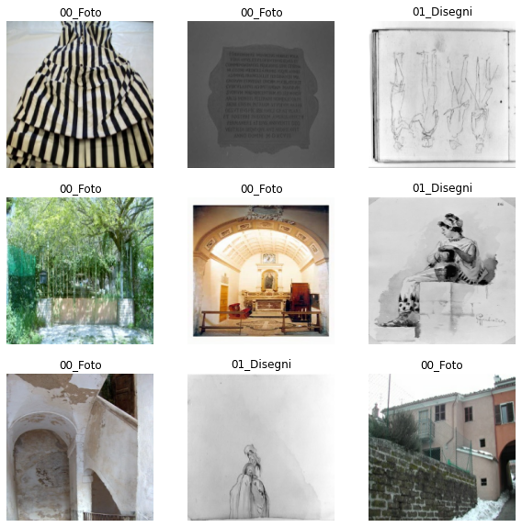
Data from dati.cultura.gov
Foto architetture (800 random)
Foto beni demoetnoantropologici (40 random)
Foto botanica (40 random)
Foto parchi e giardini (40 random)
Foto vestiti (40 random)
Foto statue (40 random)
Disegni (1000 random)
Tot of 2000 requests, 1956 files downloaded due to 44 bad files format.
Endpoint: https://dati.cultura.gov.it/sparql

Slide 3



Loss and Metrics for binary classification
Loss binary-crossentropy
Higher precision means that an algorithm returns more relevant results than irrelevant ones, and high recall means that an algorithm returns most of the relevant results (whether or not irrelevant ones are also returned).
(from Wikipedia)
Precision can be seen as a measure of quality
Metric f1 score
The F1 score is the harmonic mean of the precision and recall.
Recall as a measure of quantity (sensitivity)

Slide 4
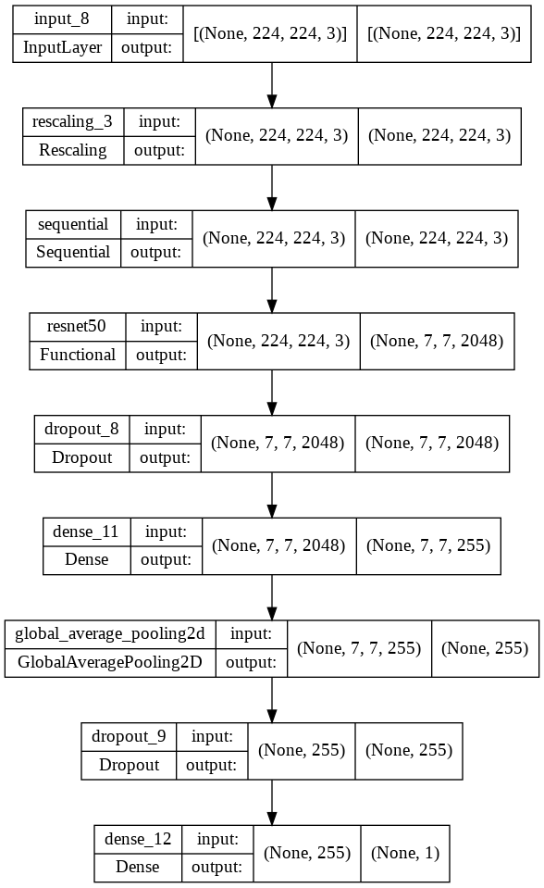
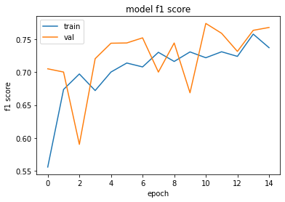
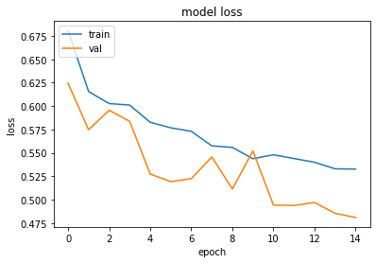
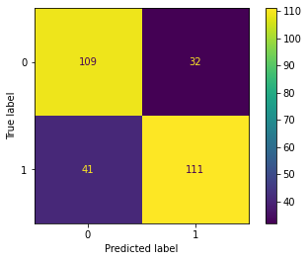
Baseline
Data (1663 files from dati.cultura.gov - 52% drawings, 48% photos)
No data augmentation
Tot n. of example for training 1331
Tot n. of example for validation 332
Tot n. of examples for test: 293
Classification Report
precision recall f1-score support
00_Foto 0.73 0.77 0.75 141
01_Disegni 0.78 0.73 0.75 152
accuracy 0.75 293
macro avg 0.75 0.75 0.75 293
weighted avg 0.75 0.75 0.75 293
Total params: 24,110,463
Trainable params: 522,751
Non-trainable params: 23,587,712

Slide 5
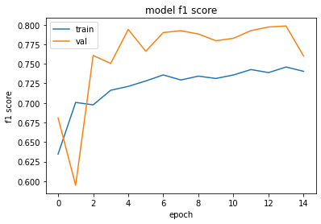
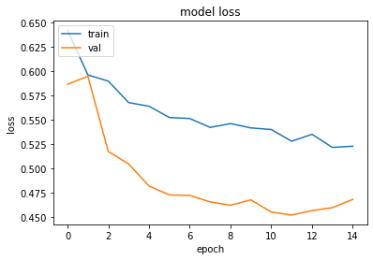
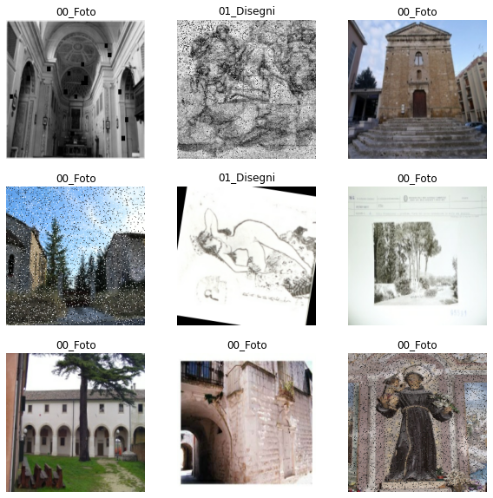
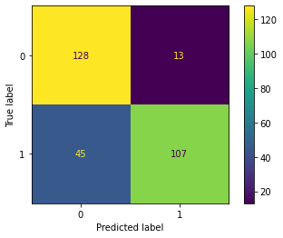
Baseline with
data augmentation
Data (1663 files from dati.cultura.gov - 52% drawings, 48% photos)
Use of data augmentation on training set (three times)
Tot n. of example for training 1331 -> (aug) -> 5324
Tot n. of example for validation 332
Tot n. of examples for test: 293
Classification Report
precision recall f1-score support
00_Foto 0.74 0.91 0.82 141
01_Disegni 0.89 0.70 0.79 152
accuracy 0.80 293
macro avg 0.82 0.81 0.80 293
weighted avg 0.82 0.80 0.80 293

Slide 6
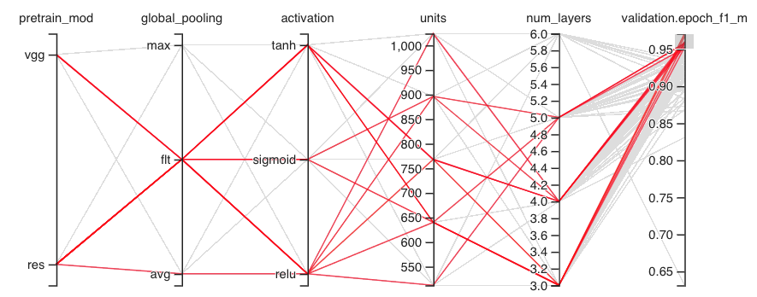
Hyper Param. optimization (Keras Hyperband)
Data: 50% of augmented data (to speed up the training)
Hyper parameter space dimension: 360
Trial completed:148 (due to free google gpu out of time)
Best F1 Score on validation: 0.9710158705711365
Total elapsed time: 03h 31m 39s

Slide 7
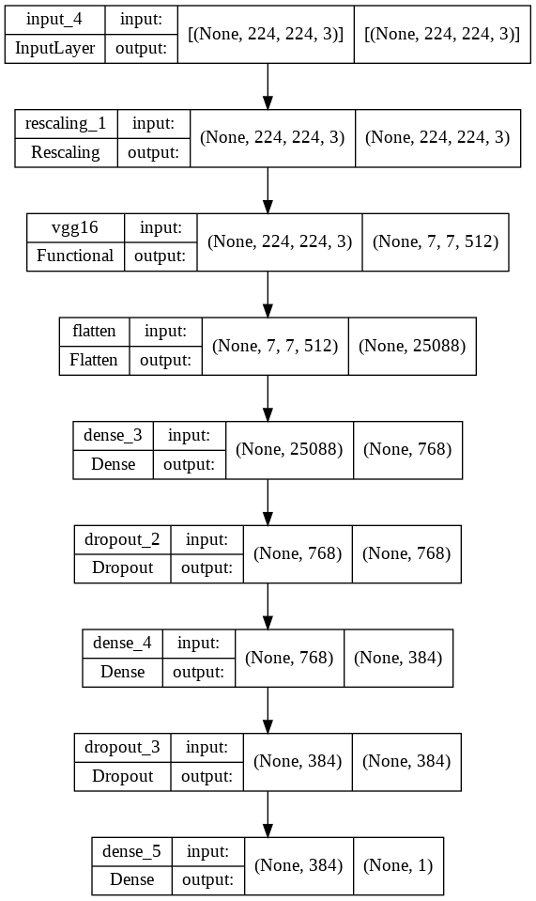
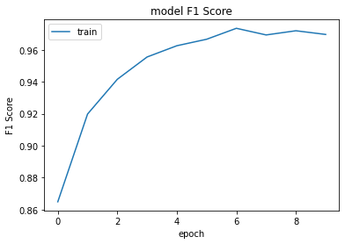
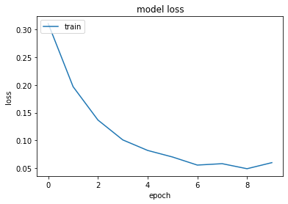
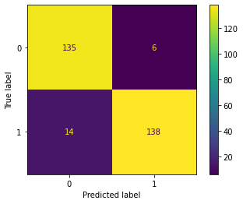
Optimized Model
Data (1663 files from dati.cultura.gov - 52% drawings, 48% photos)
Training on all augmented data (three times)
Tot n. of example for training 1663 -> (aug) -> 6652
No validation
Tot n. of examples for test: 293
Classification Report
precision recall f1-score support
00_Foto 0.91 0.96 0.93 141
01_Disegni 0.96 0.91 0.93 152
accuracy 0.93 293
macro avg 0.93 0.93 0.93 293
weighted avg 0.93 0.93 0.93 293
Total params: 34,278,721
Trainable params: 19,564,033
Non-trainable params: 14,714,688

Slide 8
More on hyperparameter optimization
Actual hardware (free Google Colab GPU) is not enough to perform an exhaustive hyperparameter research:
keras tuner on images runs for more than 4 hours (max GPU time)
keras tuner on latent space goes out of disk space
sklearn runs out of memory

Slide 9
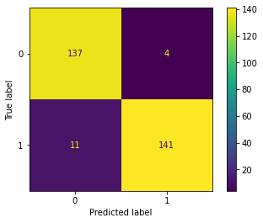
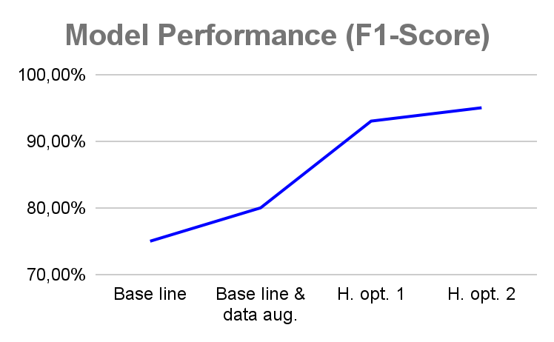
More on hyperparameter optimization
Classification Report
precision recall f1-score support
00_Foto 0.93 0.97 0.95 141
01_Disegni 0.97 0.93 0.95 152
accuracy 0.95 293
macro avg 0.95 0.95 0.95 293
weighted avg 0.95 0.95 0.95 293

Slide 10
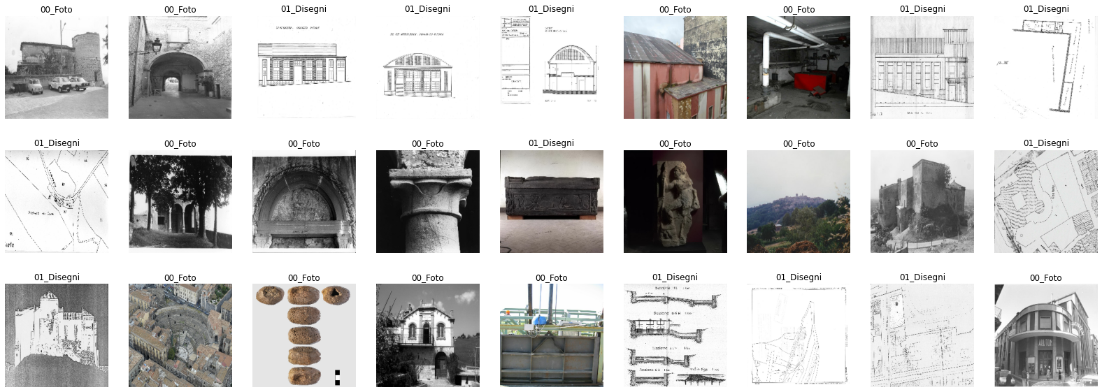
Prediction on 27 unseen images (10 drawings+ 17 photos)

Slide 11
Next steps
Check model performance with domain experts
Run the model on a dataset (randomly generated) and check the results
Decide if improve model performance or not
To improve:
Augment the number of downloaded images
Split hyperparam. optimization in more than one run
Use Docker to run on a powerful hw infrastructure
Use of ensemble learning
How to delivery to production env.

Slide 12
Thank you
Fabio D’Amore
fabio.damore@istc.cnr.it

